Slide 1


Welcome to
Music City Data User Group
Nashville's SQL Server & Microsoft Data Platform Community
Tuesday, August 4, 2026 · Tonight's Speaker: Brian Dill

Slide 2
Tonight's Agenda
5:30 – 6:00 Networking, Food & Drinks
Grab a seat, meet fellow data pros
6:00 – 6:15 Welcome & Announcements
Community updates
6:15 – 7:15 Presentation
DuckDB 101 - Zero to 500 Million in Less Than a Second
7:15 – 7:30 Questions & Networking
Wrap up conversations before you head out
Brian Dill · DuckDB 101 - Zero to 500 Million in Less Than a Second

Slide 3
Thank You to Our
Host & Sponsor
Vaco by Highspring
5501 Virginia Way, Suite 120 · Brentwood, TN
Thank you for the space, refreshments, and community support!

Slide 4
What is MC-DUG?
Music City Data Users Group
Nashville's community for data professionals focused on SQL Server & the Microsoft Data Platform.
Who it's for: DBAs · Developers · Data Engineers · Analysts · Architects · Anyone learning data
Topics: SQL Server & Azure SQL · T-SQL & Performance · PowerShell & Automation · Data Engineering & Warehousing · Career Growth
Come for the data. Stay for the community.

Slide 5
Meet the Organizers
Jason Romans — Lead Organizer
Microsoft MVP based in Nashville, focused on Microsoft Fabric, Power BI & data modeling.
Blog: thedaxshepherd.com
Kevin Kline — Co-Organizer
Microsoft Data Platform MVP for 20+ years; Founder & former President of PASS.
Also known for: Co-author, SQL in a Nutshell (O'Reilly)
Two organizers. One growing Nashville data community.

Slide 6
Where to Find Us
Our Home
musiccitydata.org (redirects to Meetup)
Join on Meetup
meetup.com/music-city-data-user-group
Want to Speak?
Session submissions coming soon
Contact
organizers@musiccitydata.org

Slide 7
Stay Connected
Meetup — The main place for upcoming meetings & activities
Check Meetup for the next session, RSVPs, and announcements
Email — Reach the organizers anytime
organizers@musiccitydata.org
GitHub —
Mainly for slides: slides.musiccitydata.org
Code of Conduct: conduct.musiccitydata.org

Slide 8
Code of Conduct
We're all here to learn and grow together.
Please keep things:
Respectful — treat everyone with courtesy
Professional — keep discussions constructive
Inclusive — everyone belongs here
No spam or solicitation
Full Code of Conduct: conduct.musiccitydata.org

Slide 9
Other Microsoft Communities in Nashville
Coming up at other Nashville groups:
Nashville Power BI User Group
“From Tableau to Power BI: A Real World Transition Guide” — TBD· 5:00 PM meetup.com/nashville-modern-excel-user-group
Nashville Microsoft Azure Users Group
“Corral Your Azure Platform Services with Network Security Perimeters” — Wed, Aug 12 · 5:30 PM meetup.com/the-nashville-microsoft-azure-users-group
Nashville .NET User Group
Monthly Meeting — Thu, Aug 13 · 5:30 PM meetup.com/nashdotnet

Slide 10
More Nashville Data Communities
Coming up at other Nashville groups:
Microsoft 365 Users Group of Nashville & Knoxville
meetup.com/m365usergroup
Nashville Data Nerds
“Building an Agentic App using Microsoft Foundry” — Wed, Aug 5 · 5:00 PM meetup.com/data-nerds

Slide 11
New Speakers Welcome!
Interested in presenting but haven't done it before? We'd love to help you get started. Here are some easy ways to ease in:
Lightning Talks — 5–10 minutes on a tip, tool, or lesson learned
Short Session Before the Main Talk — A 15–20 min opener to warm up the room
Full Presentation — When you're ready for the full stage
No experience needed — just a willingness to share!

Slide 12
New Certification Alert: DP-800
Microsoft just launched a new certification for SQL pros diving into AI:
Microsoft Certified: SQL AI Developer Associate — Microsoft's newest cert, GA since May 2026
What it covers — T-SQL AI functions, vector embeddings, semantic search & RAG
Where it applies — SQL Server, Azure SQL & Fabric SQL databases
Free cert offer — Join Fabric Data Days 2026 for a free cert
Learn more — learn.microsoft.com/credentials/certifications/developing-ai-enabled-database-solutions
A great next step after T-SQL.

Slide 13
Upcoming Events
Mark your calendars for these free community data conferences:
Nashville Microsoft Community Day Friday, September 11 · Nelson Andrews Leadership Center
Day of Data Salt Lake City Saturday, September 19 · Neumont University
Day of Data St. Louis Saturday, October 24 · Microsoft Technology Center

Slide 14
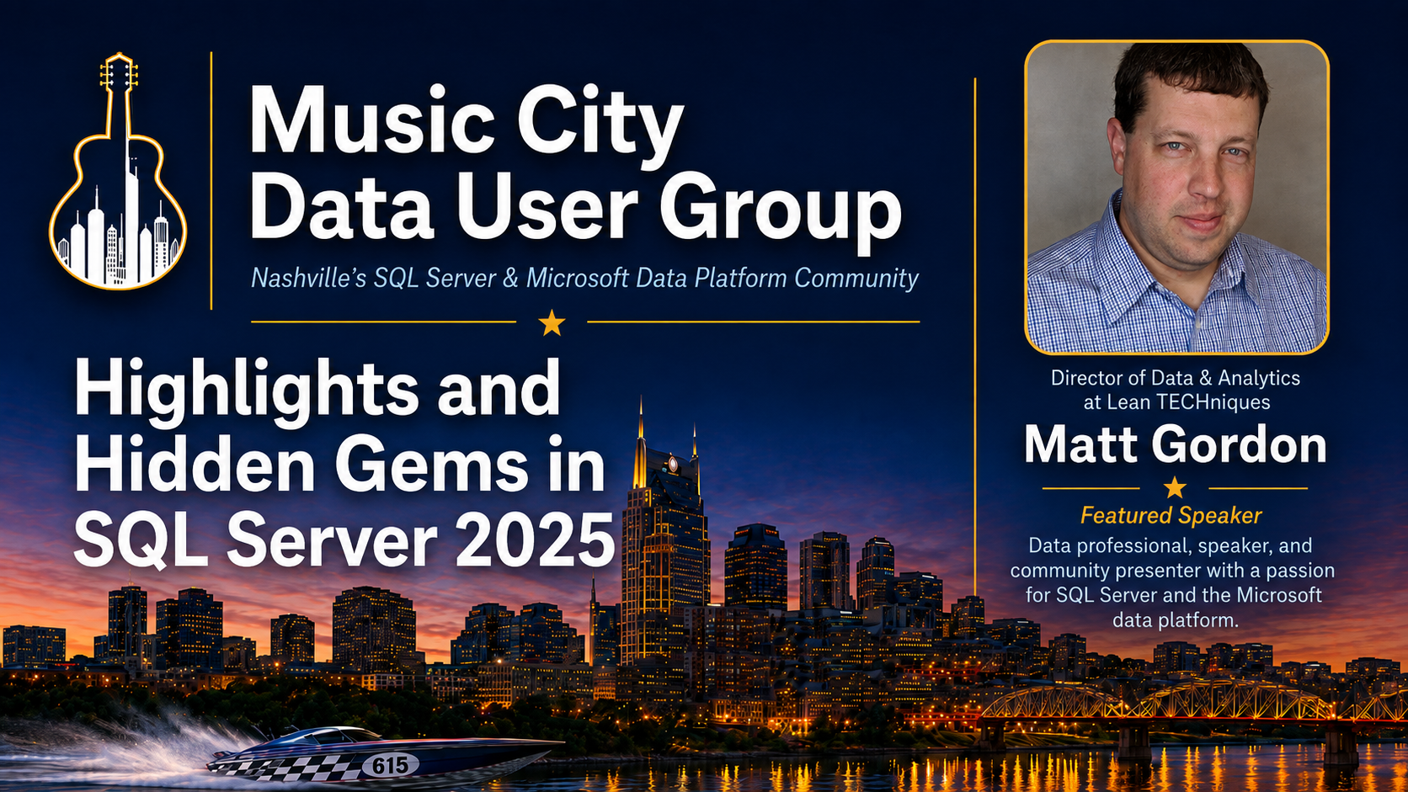
Next Meeting – Sept 3
RSVP at musiccitydata.org once listed

Slide 15
Our Meeting Cadence
We’re trying to settle into a monthly rhythm — 1st Tuesday of the month at Vaco:
Thursday Sep 3
Wednesday Oct 7
Tuesday Nov 3
Tuesday Dec 1
October or December – most likely Intro to DBATools as topic

Slide 16
Get the Slides
slides.musiccitydata.org
Hosted on GitHub
Presentation decks may be available if not hosted by speaker
All slides are open and freely available

Slide 17
About Brian Dill
30-year Nashville-area SQL Server DBA, recently pivoted into data engineering
Automates with PowerShell, visualizes in R, and works across SQL Server, PostgreSQL, MySQL, SQLite & DuckDB

Slide 18
NOW
Brian Dill
DuckDB 101 - Zero to 500 Million in Less Than a Second
SELECT * FROM community

